Slide 1
Sports Science

Slide 2
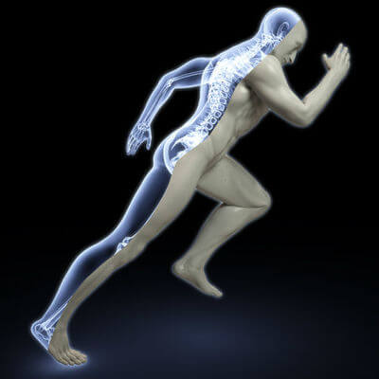
By the end of this lesson, you should be able to answer the following questions about sports science:
• | What is a technique (from any sport) which helped athletes improve their performance?
• | What is a material (from any sport) which helped athletes improve their performance?

Slide 3
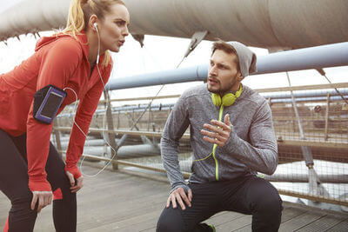
Sports science uses ideas from a range of fields, including anatomy, physiology and biomechanics, to improve an athlete's performance.
Lots of careers involve sports science, such as sports coaches, sports therapists and dieticians.

Slide 4


Slide 5
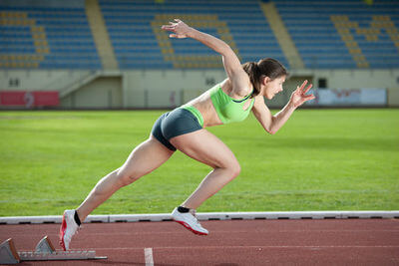
Most sports involve running faster, jumping higher or throwing further than anyone else.
Understanding the forces involved can help the athlete improve, giving them an advantage over the people they're competing against.

Slide 6
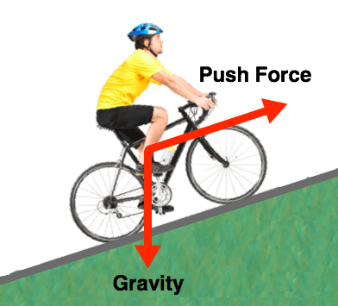
When you play sports, there are usually forces which are working for you and forces which are working against you.
For example, if you bike up a hill, the force of gravity tries to pull you down.
If you go running, you use friction to push yourself forwards while air resistance pushes you backwards.

Slide 7
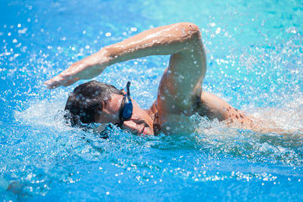
Sports science helps athletes by improving their techniques and the materials the athletes use.
The main force which acts against athletes is drag. Therefore, most of these techniques and materials improve performance by reducing drag.
Drag is a force which acts in the opposite direction to the motion of the object. It includes friction and air resistance

Slide 8
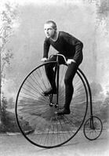
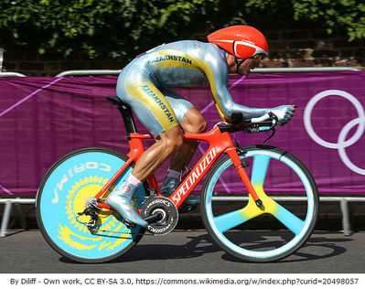
Better materials are constantly being developed by sports scientists.
These new materials allow athletes to set new records every year. Looking at the pictures of cyclists below, it isn't hard to see how better materials can improve performance!

Slide 9
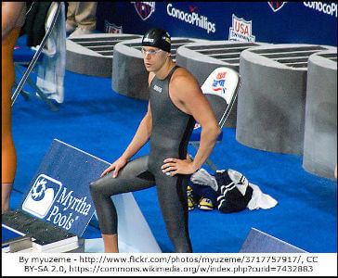
A new type of swimsuit, called the LZR Racer, was developed by Speedo. This swimsuit reduced drag and increased buoyancy.
In the 2008 Olympics, 23 world records were broken by swimmers wearing the LZR Racer. 98% of medal winners were wearing this swimsuit.

Slide 10
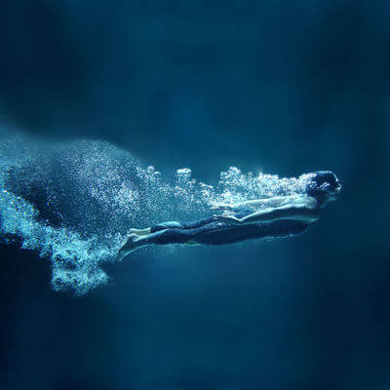
However, the LZR Racer was only available to swimmers who were sponsored by Speedo.
This lead FINA (an international body which regulates swimming competitions) to ban this swimsuit because it gave some competitors an unfair advantage.

Slide 11
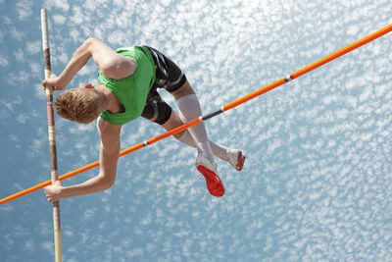
Pole vaulters have also benefited from the development of new materials.
Until the 1950s, pole vaulters used stiff bamboo poles. Replacing these poles with flexible fibreglass poles provided a larger upwards force, improving the performances of the pole vaulters.
These fibreglass poles were quickly made available to everyone, so no one had an unfair advantage.

Slide 12
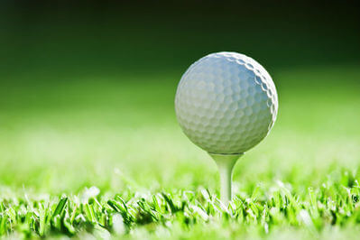
Golf balls have been specially designed to reduce drag acting on them.
Modern golf balls are covered in small dimples. These dimples reduce the drag force acting on the ball and allow a larger lift force to be generated.
This means the ball can travel further.

Slide 13
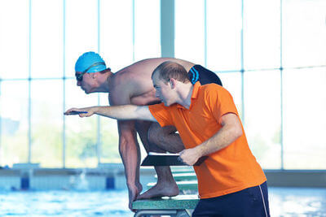
Sports scientists also think of ways for athletes to improve their technique based on ideas from physics.
This means that athletes can perform better as their techniques improve.

Slide 14
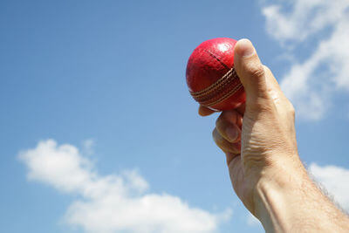
One technique which is used when bowling in cricket is spinning the ball.
By spinning the ball, the bowler can influence the forces acting on the ball as it bounces off the pitch. This causes the ball to bounce at a funny angle so that it doesn't travel in a straight line. This is much harder for the batter to hit!
Other bowlers apply as much force to the ball as possible so that it travels very quickly. This is also very difficult to hit.

Slide 15
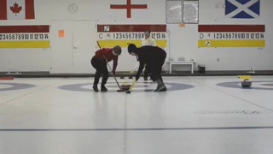
In curling, players slide heavy rocks over ice and try to get them as close to the target as possible.
The sweepers sweep the ice in front of the rock. This reduces the friction acting on the rock, which enables it to travel further. Sweeping the ice can also affect the direction which the rock travels in.

Slide 16
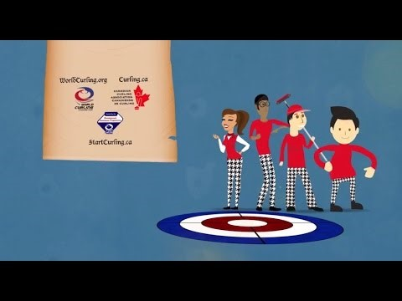

Slide 17
Gymnasts also need to understand the forces acting on them as they leap, flip and tumble.
They need to understand the friction acting on them so that they can balance. When they land, they need to bend their knees to reduce the contact forces acting on them and prevent injury.

Slide 18
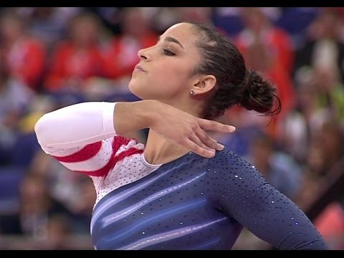

Slide 19
This technique is based around the jumper having a low centre of mass. The centre of mass is the average position of all your mass.

Slide 20
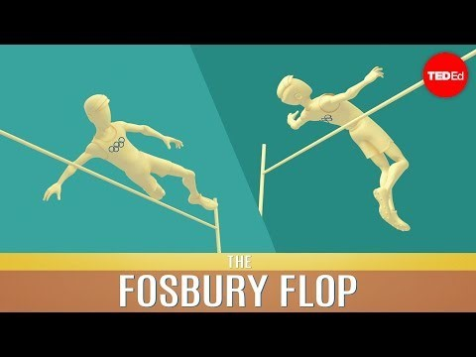

Slide 21
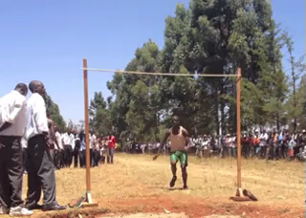
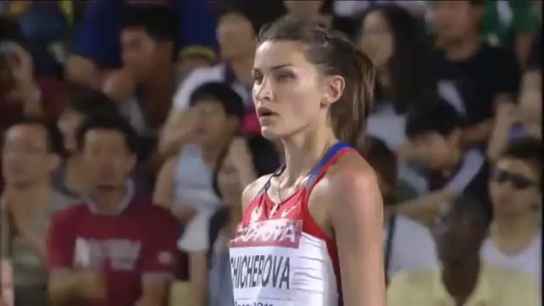
Before the Fosbury Flop was invented, most high jumpers used the straddle technique. In this technique, they face the bar while their legs straddle it. This meant that the centre of mass needed to pass over the bar.
In the Fosbury Flop, high jumpers arch backwards over the bar. This means that their centre of mass stays below the bar.

